Slide 1

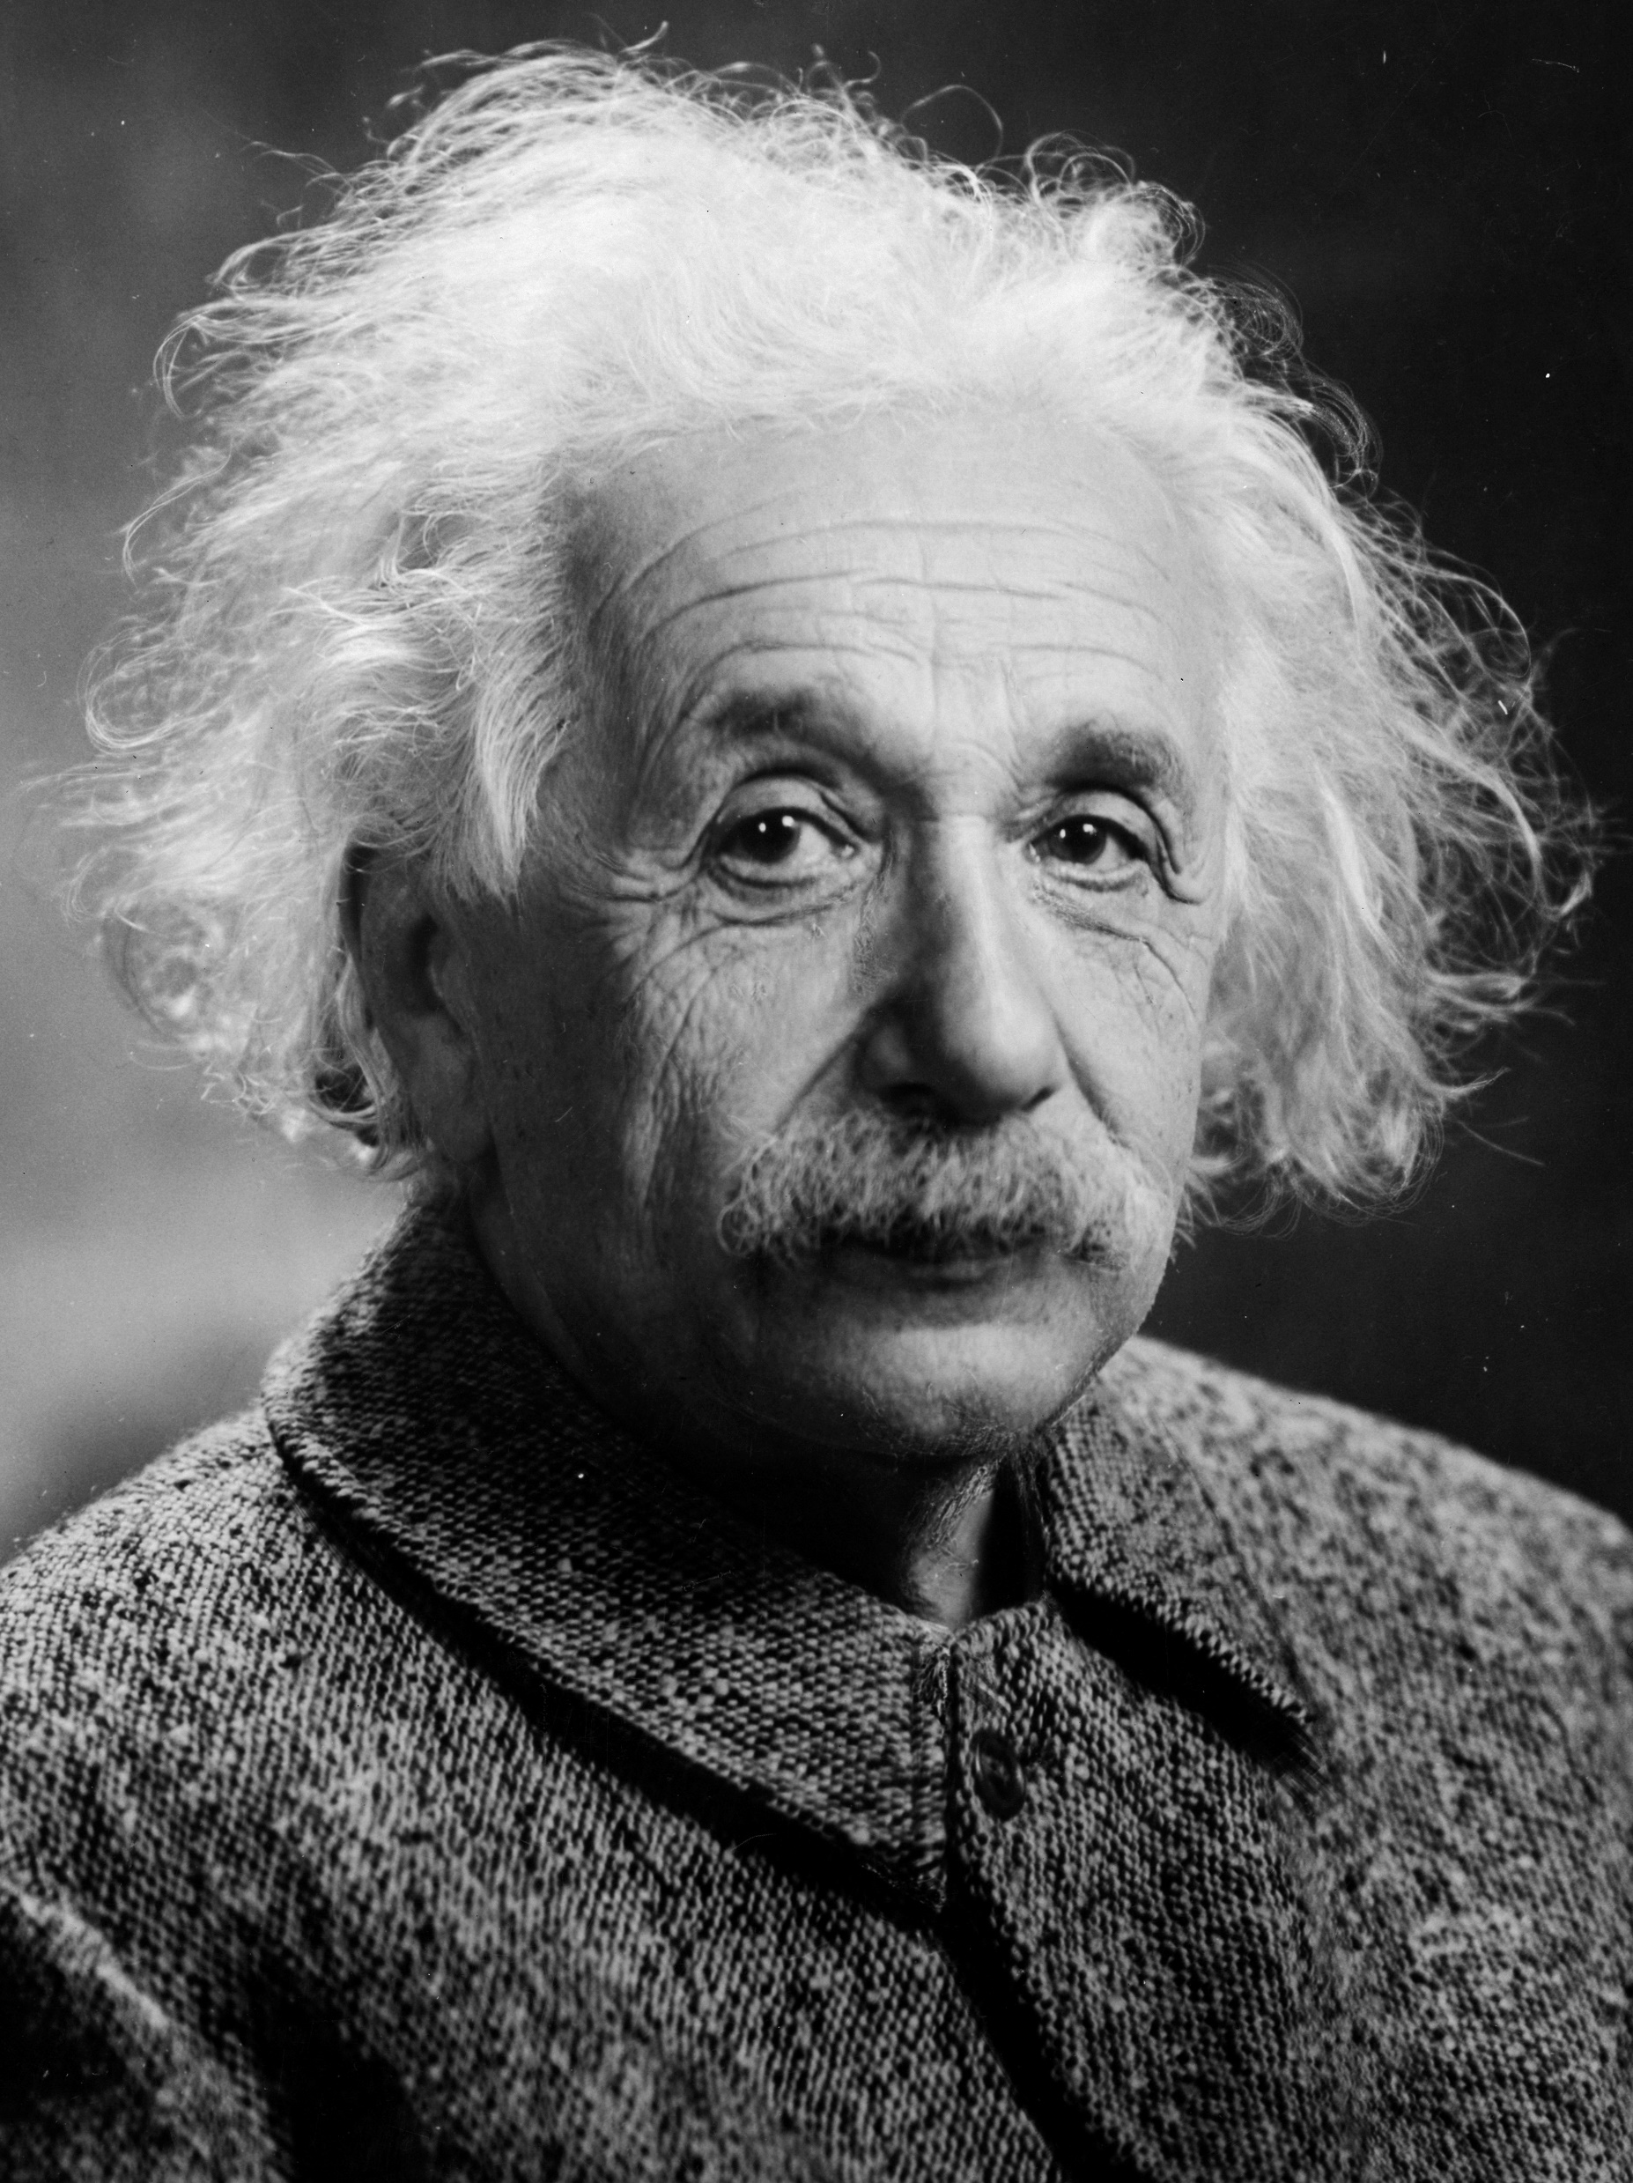
ALBERT
EINSTEIN

Slide 2
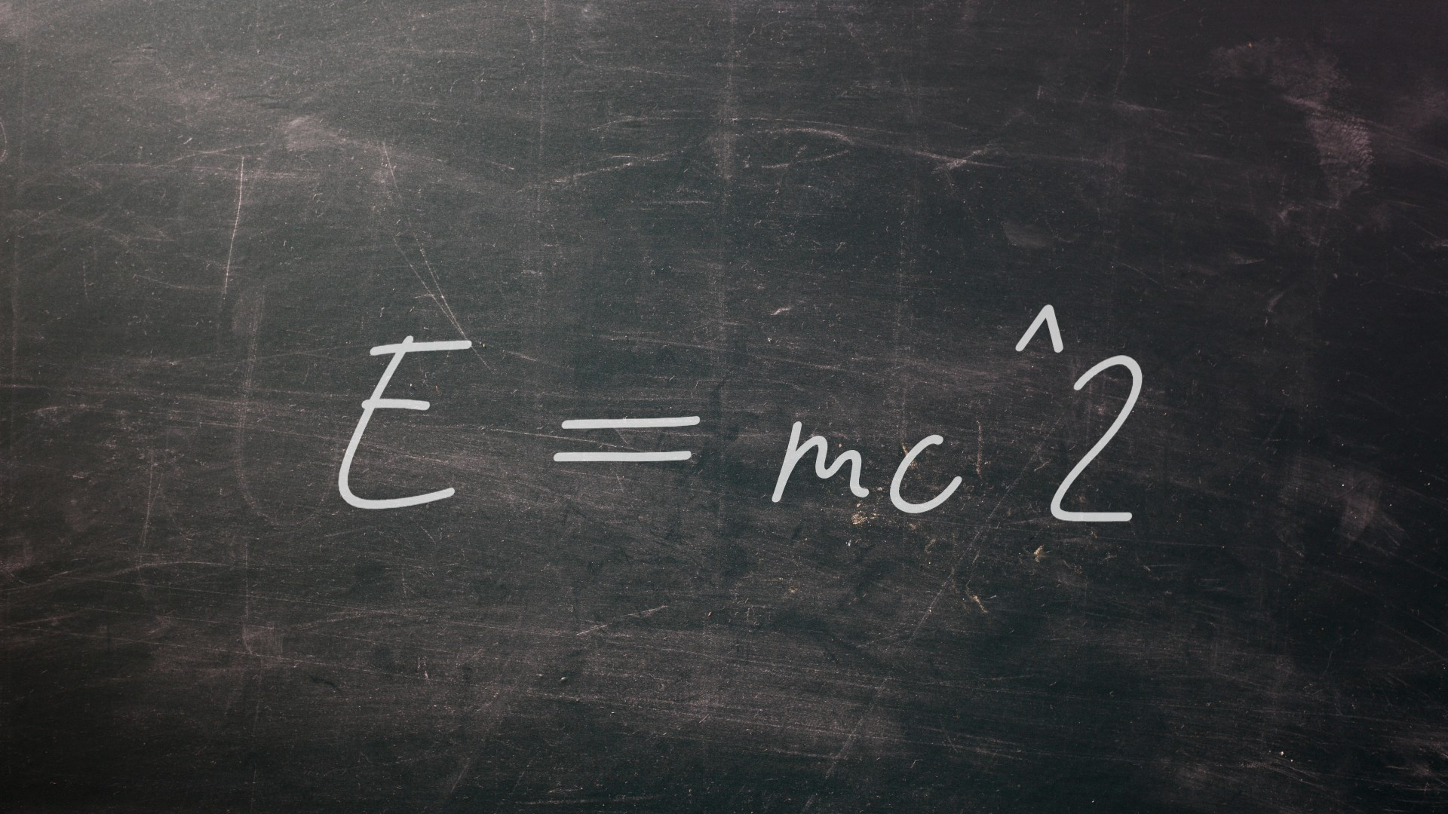
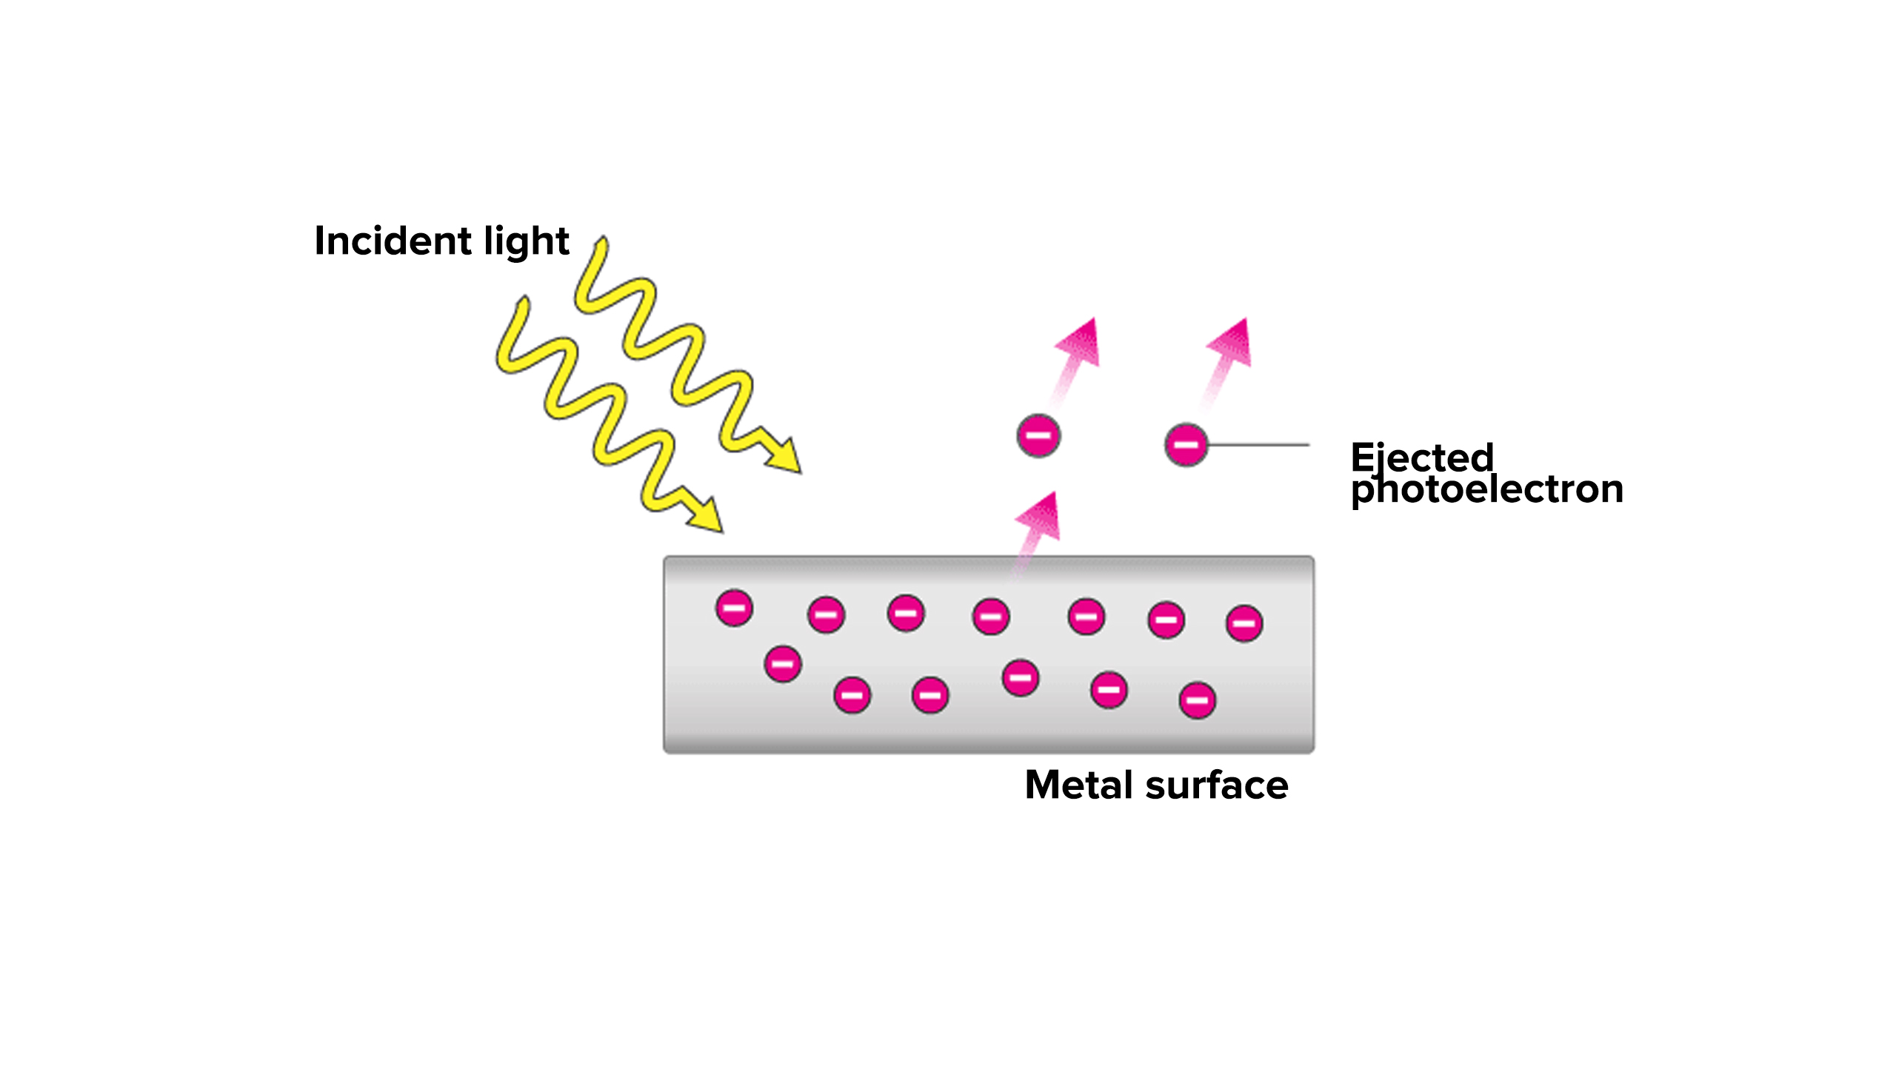
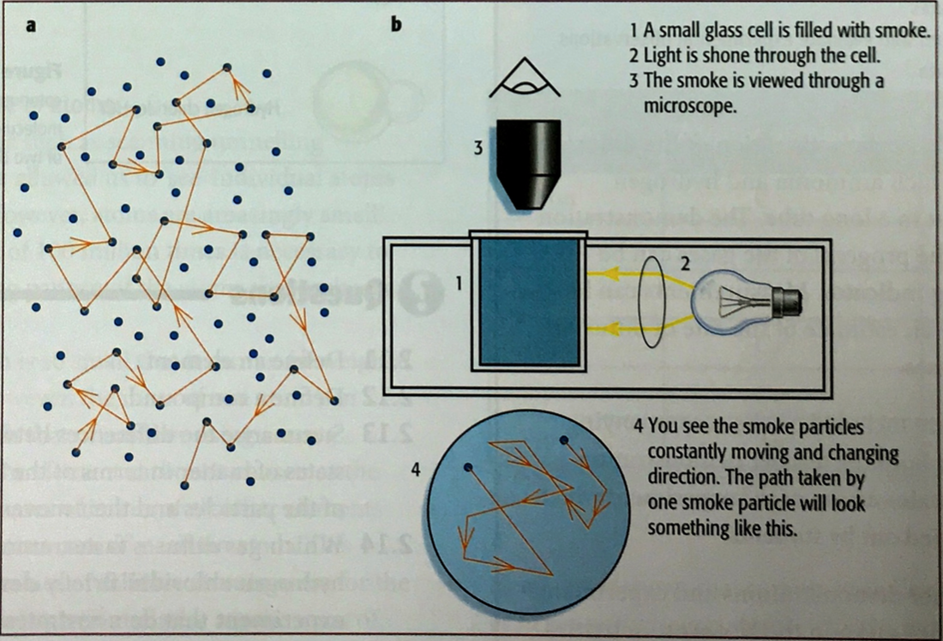
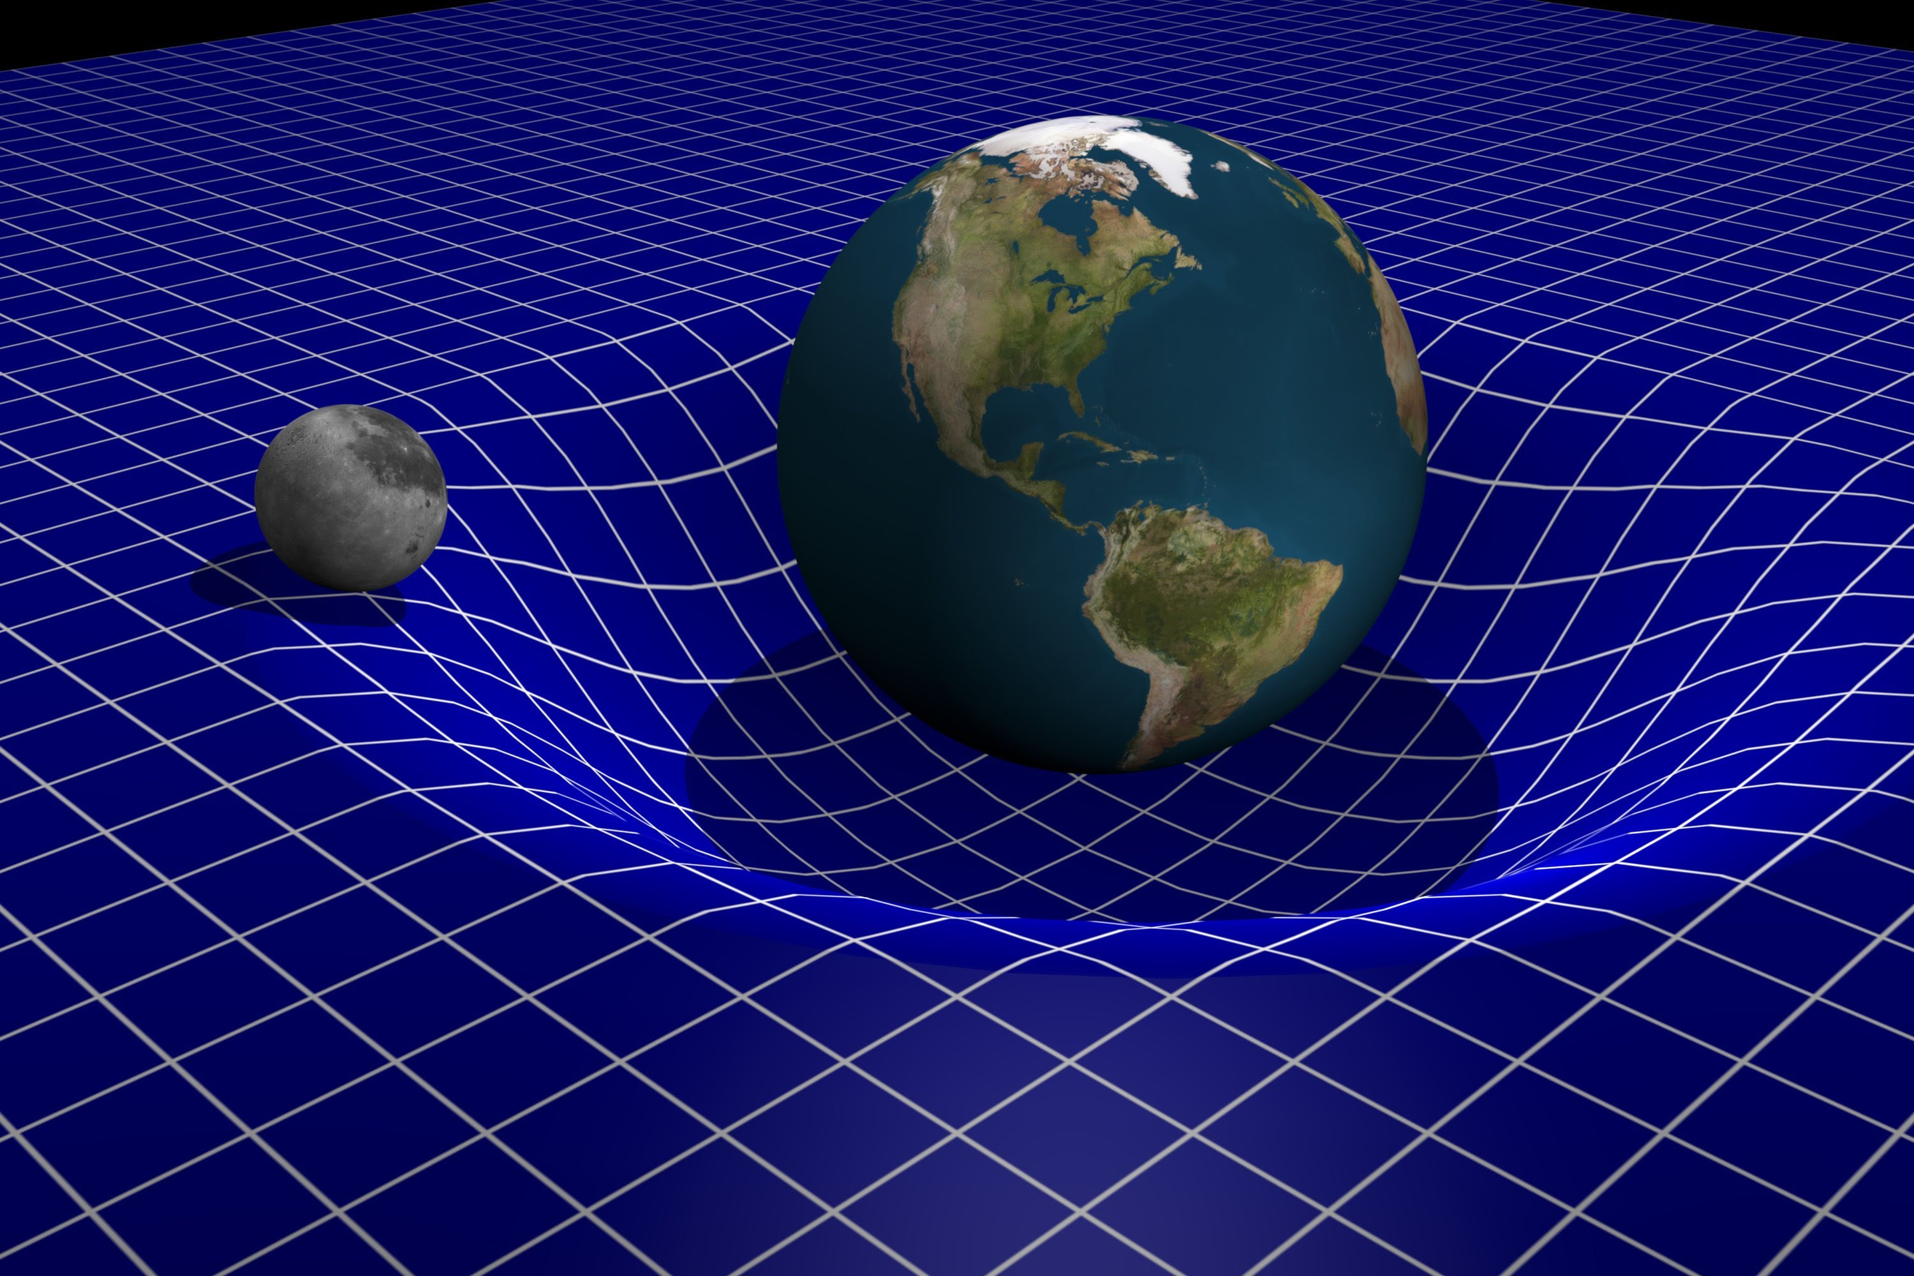
Albert Einstein
Innovation

Slide 3
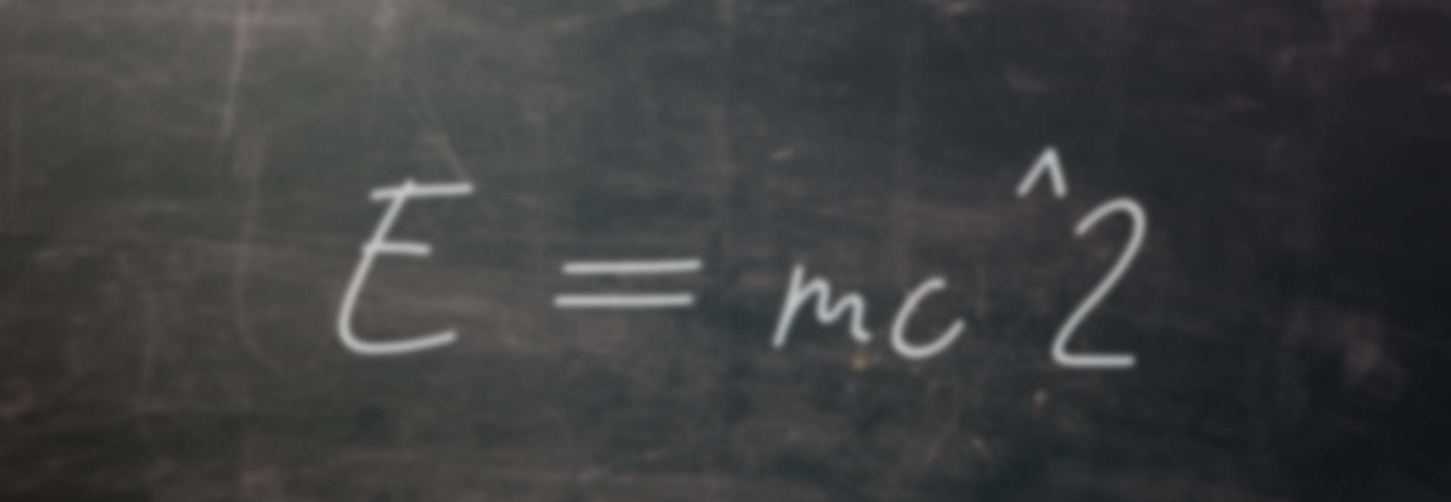
Albert Einstein
Mass-Energy Equivalence
Innovation
1905

Slide 4
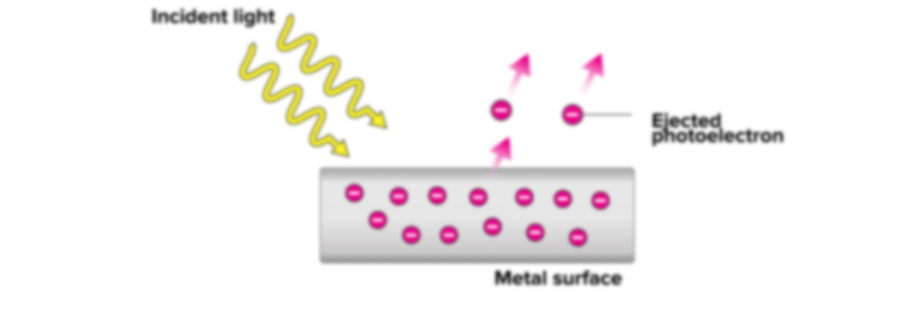
Albert Einstein
Mass-Energy Equivalence
Photoelectric Effect
1905
Innovation
1905

Slide 5
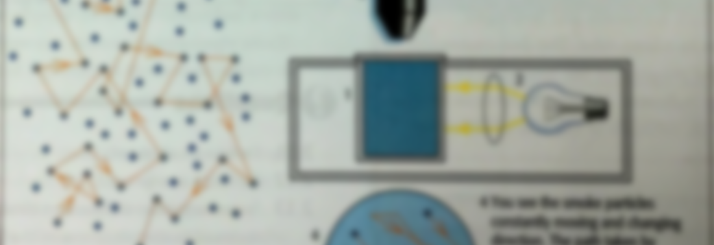
Photoelectric Effect
Albert Einstein
Mass-Energy Equivalence
1905
Brownian Motion
Innovation
1905

Slide 6
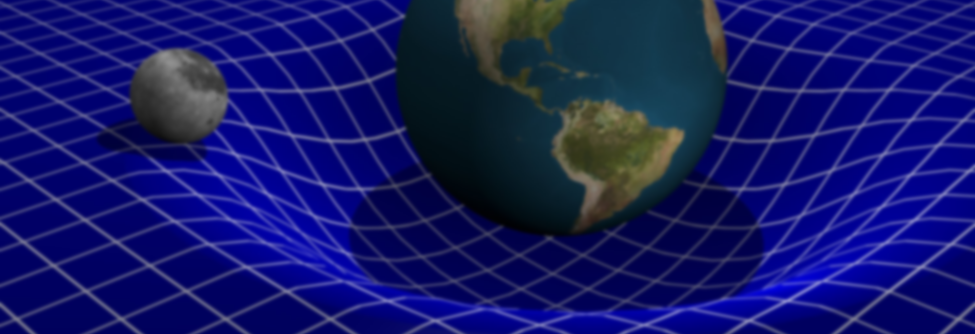
Albert Einstein
Brownian Motion
Photoelectric Effect
Mass-Energy Equivalence
Generalized Theory of Gravitation
1905
1905
Innovation
1948

